Slide 1
Self-Normalizing Neural Networks
Giinter Klambauer, Thomas Unterthiner, Andreas Mayr
NIPS 2017
Information & Intelligence System Lab.
Sang Heon Lee
lawlee1@naver.com
2018/03/26

Slide 2
Contents
Introduction
Background
Proposed Method
Experiments
Conclusion

Slide 3
Introduction
Success stories of standard feed-forward neural networks(FNNs) that have many hidden layers are rare.
Won challenges that are not related to vision or sequential tasks
: gradient boosting, random forest, SVMs > FNNs with at most 4 hidden layers.
Train very deep NN : Use Normalization
Batch, Layer, Weight Normalization
Training with normalization techniques is perturbed
by SGD, stochastic regularization, the estimation of normalization parameters.
RNNs and CNNs can stabilize learning via weight sharing.
FNNs suffer from perturbations and have high variance in training error
Reasons of less successful of FNNs is sensitivity to perturbations.

Slide 4
Introduction (cont’d)
Proposed self-normalizing neural networks(SNNs)
Robust to perturbations.
No high variance in their training errors.
Push neuron activations to zero mean and unit variance.
Based on Scaled exponential linear units “SELUs”

Slide 5
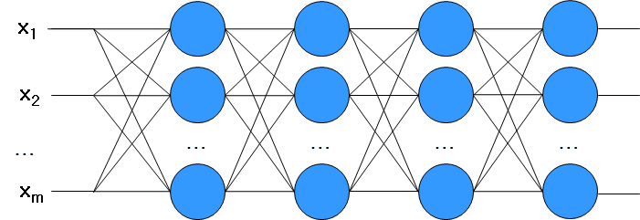
Background
Internal Covariance Shift
A small change in previous layers leads a large change in the later
Need normalization.
Distribution of inputs of a node is easy to shift very fast

Slide 6
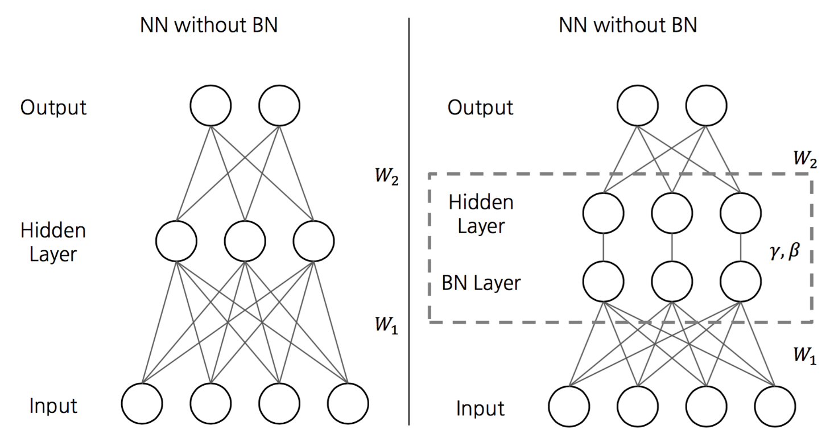
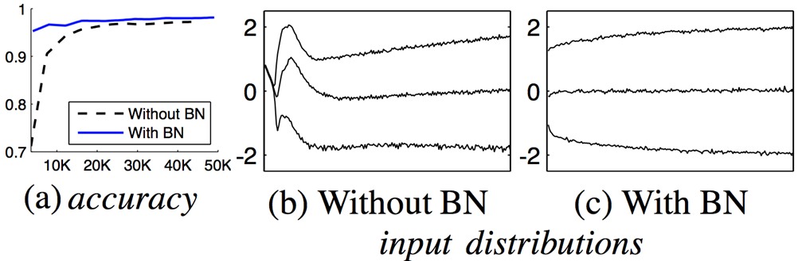
Background (cont’d)
Batch normalization
Normalize each batch by both mean and variance.
Perturbed by SGD, regularization(dropout)

Slide 7
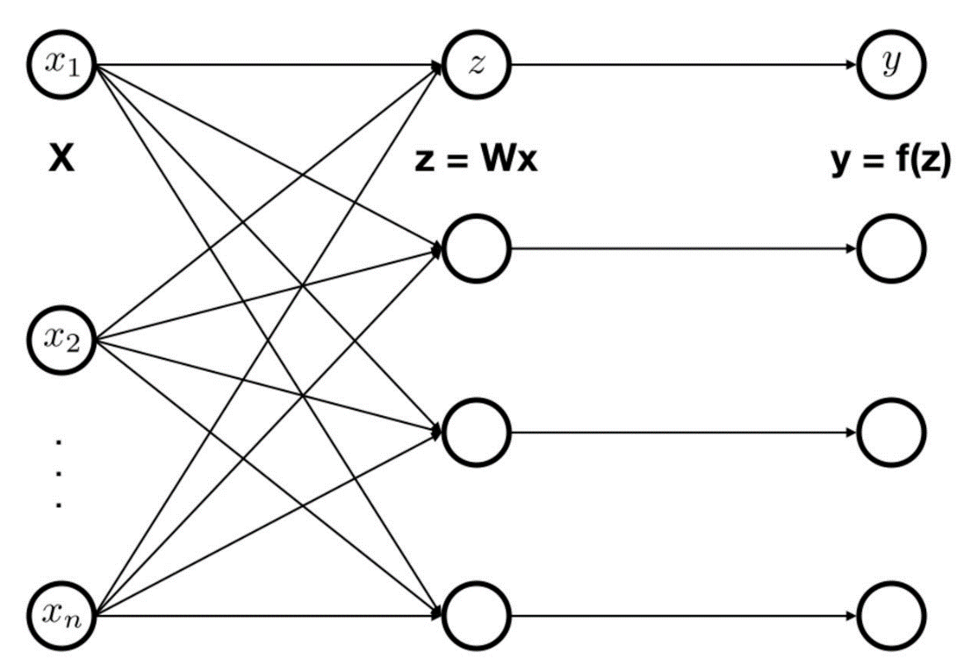



Proposed Method
Notation
Lower layer activations : x
Weight matrix : W
z = Wx
Activation function : f
Higher layer activations : y = f(z)
Mean of weight vector
Second moment
Mapping
(μ, ν)
($\tilde{μ}$, $\tilde{\text{ν}}$)
g

Slide 8


Proposed Method (Cont’d)
Self-normalizing Neural Net
It possesses mapping
It has a stable and attracting fixed
point depending on
Mean and variance remain in domain
(μ, ν)
($\tilde{μ}$, $\tilde{\text{ν}}$)
g

Slide 9

Constructing SNNs
Scaled Exponential Linear Uints (SELUs)
Activation Function is required to have
Negative and positive values → No ReLU
Saturation regions (derivative approaching 0) to dampen the variance if it’s too large.
A slope larger than 1 to increase the variance it it’s too small → No ELU
A continuous curve
(2) Weight initialization
Normalized. ω = 0, τ = 1.
Prove the self-normalizing property when weight vectors are not normalized.

Slide 10

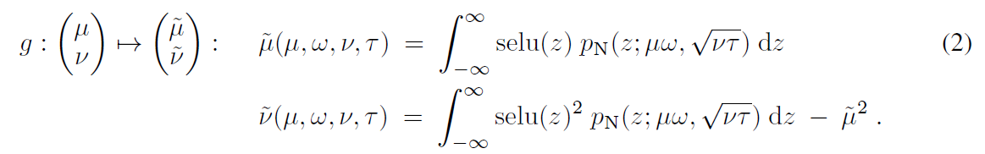
Deriving Mapping Function g
Xi are independent from each other, but share same mean and variance
z = Wx = wTx
Central Limit Theorem (CLT) :
y = f(z)

Slide 11
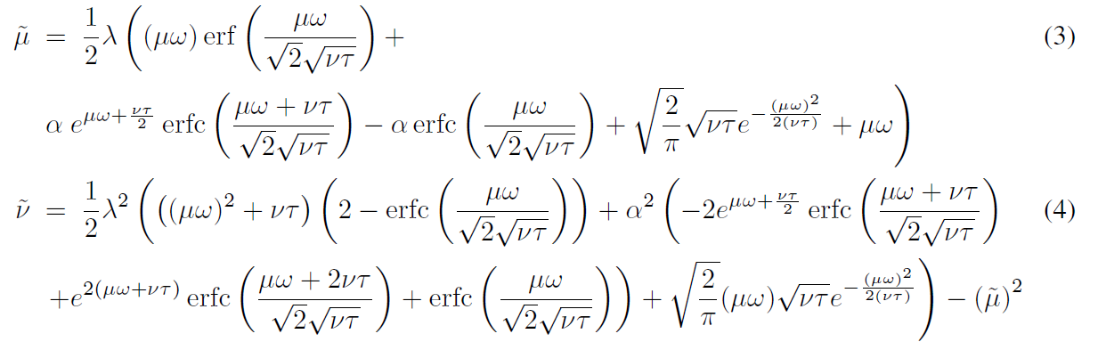
Deriving Mapping Function g (Cont’d)

Slide 12
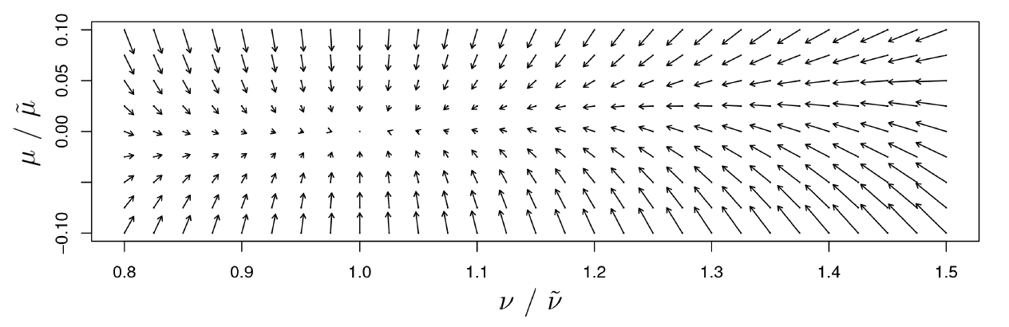
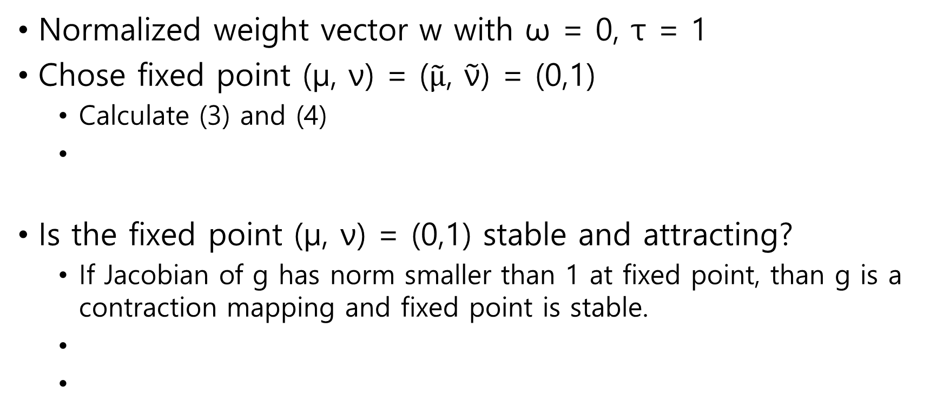
Stable Fixed Point (0,1) for Normalized Weights
Normalized weight vector w with ω = 0, τ = 1
Chose fixed point (μ, ν) = ($\tilde{μ}$, $\tilde{\text{ν}}$) = (0,1)
Calculate (3) and (4)
Is the fixed point (μ, ν) = (0,1) stable and attracting?
If Jacobian of g has norm smaller than 1 at fixed point, than g is a contraction mapping and fixed point is stable.

Slide 13
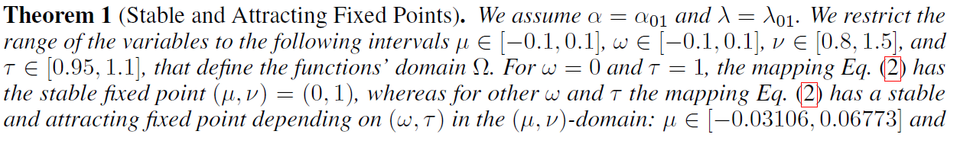
Stable Fixed Points for Unnormalized Weights
Normalized weight vector w cannot be ensured during learning.
If we restrict (μ, ν, ω, τ) to certain intervals,
(μ, ν) is mapped to the respective intervals.
Proof : Jacobian of g → spectral norm of g < 1 : contraction mapping.

Slide 14
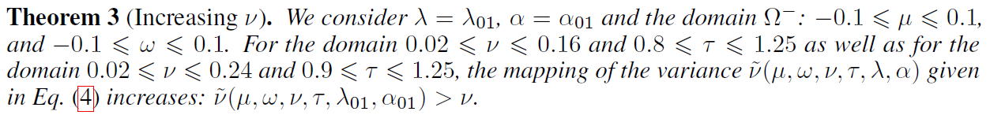
Properties of SELUs
SELUs perform variance damping and variance increasing.
Variance damping is stronger if net inputs are away from zero.
Variance increase is stronger if net input are close to zero.
Variance of neuron activation of SNNs is bounded.

Slide 15
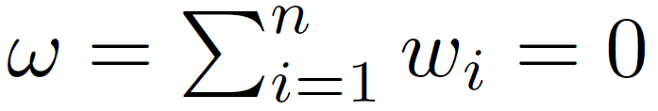



Initialization of SNNs
Weight initialization
,
Draw the weights from a Gaussian Distribution
with ,

Slide 16

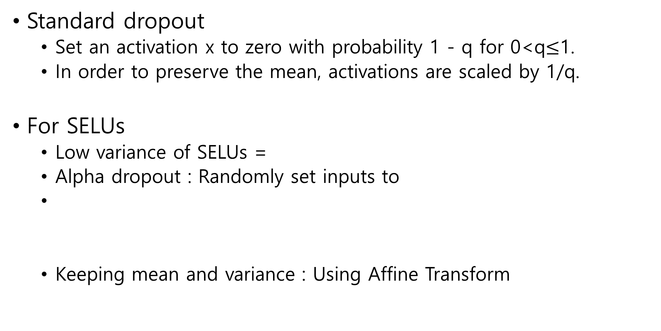
New Dropout Technique
Standard dropout
Set an activation x to zero with probability 1 - q for 0<q$≤$1.
In order to preserve the mean, activations are scaled by 1/q.
For SELUs
Low variance of SELUs =
Alpha dropout : Randomly set inputs to
Keeping mean and variance : Using Affine Transform

Slide 17

New Dropout Technique (Cont’d)
For SELUs
Keeping mean and variance : Using Affine Transform
With μ = 0 and ν = 1,
a, b only depend on the dropout rate 1-q and
Empirically, 1-q = 0.05 or 0.10 is good.

Slide 18
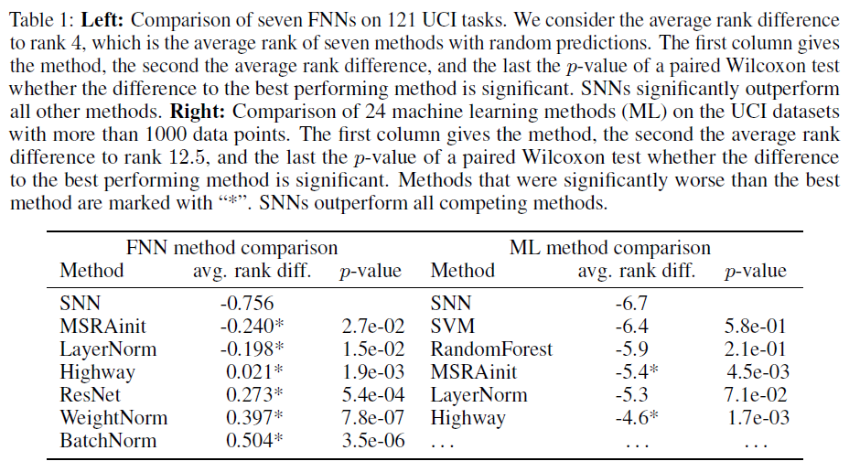
Experiments
1. 121 UCI Machine Learning Repository datasets.
121 classification datasets from diverse application areas (physics, geology, biology)
Size of dataset : 10~130,000 , # of features : 4~250.
Small dataset (<1000)
SVM, random forest > SNNs
Large dataset (>1000)
SNNs > SVM, random forest
Average depth of SNNs = 10.8
BatchNorm = 6, WeightNorm = 3.8,
LayerNorm = 7, Highway = 5.9

Slide 19
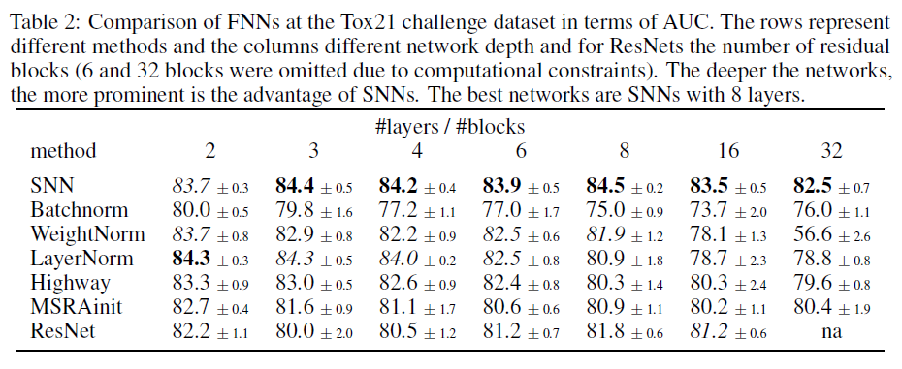

Experiments (Cont’d)
2. Drug discovery : The Tox21 challenge dataset.
12,000 chemical compounds whose 21 toxic effects have to be predicted based on their chemical structure.
2015, US NIH was won by ensemble of shallow ReLU FNNs, AUC=0.846.
SNNs came close with an AUC of 0.845$±$0.003.

Slide 20
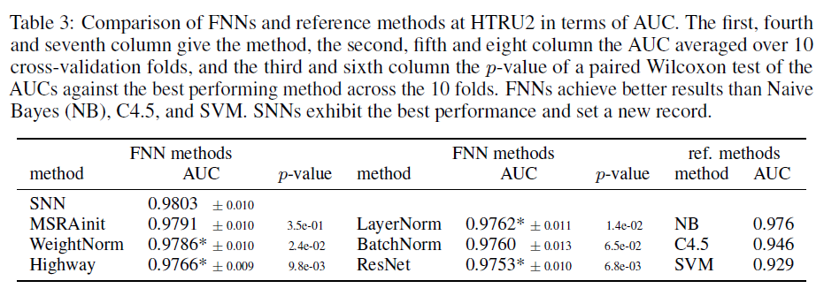
Experiments (Cont’d)
3. Astronomy : Prediction of pulsars in the HTRU2 dataset.
Identify pulsars in radio wave signals.
HTRU2 dataset : 1,639 real pulsars and 16,259 spurious signals.

Slide 21
Conclusion
SNNs work well with the following configuration
SELU activation with parameters
Inputs normalized to zero mean and unit variance
Network weights initialized with variance 1/n
Regularization with “alpha-dropout”
SNNs do not face vanishing and exploding gradient problems.
Exist upper and lower bound on the variance mapping.
SNNs work well for architectures with many layers.
Best performing SNNs are typically very dip in contrast to other FNNs

